Slide 1
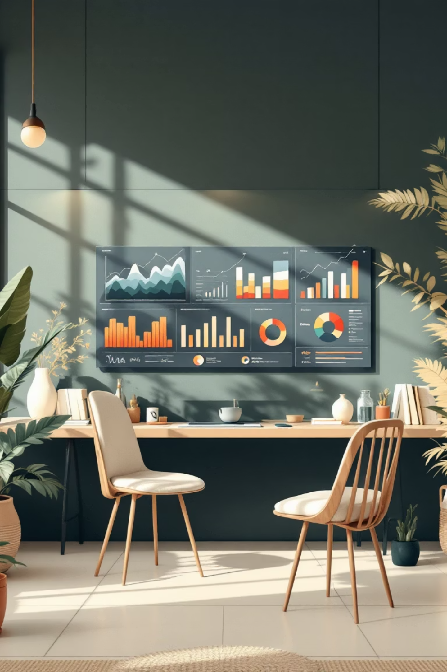
Customer Shopping Behavior Analysis
Uncovering insights from 3,900 purchases to guide strategic business decisions

Slide 2
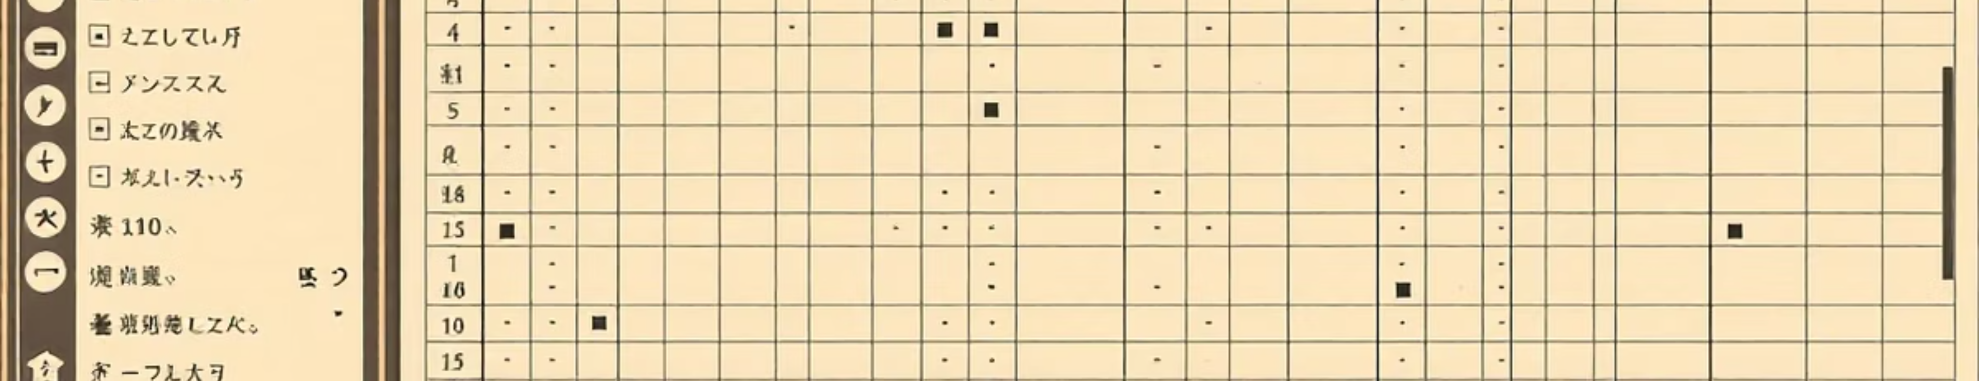
OVERVIEW
Dataset at a Glance
3.9K
18
4
Total Purchases
Data Points
Categories
Transactions analyzed
Features per transaction
Product segments
Key features include customer demographics, purchase details, and shopping behavior patterns across multiple dimensions.

Slide 3
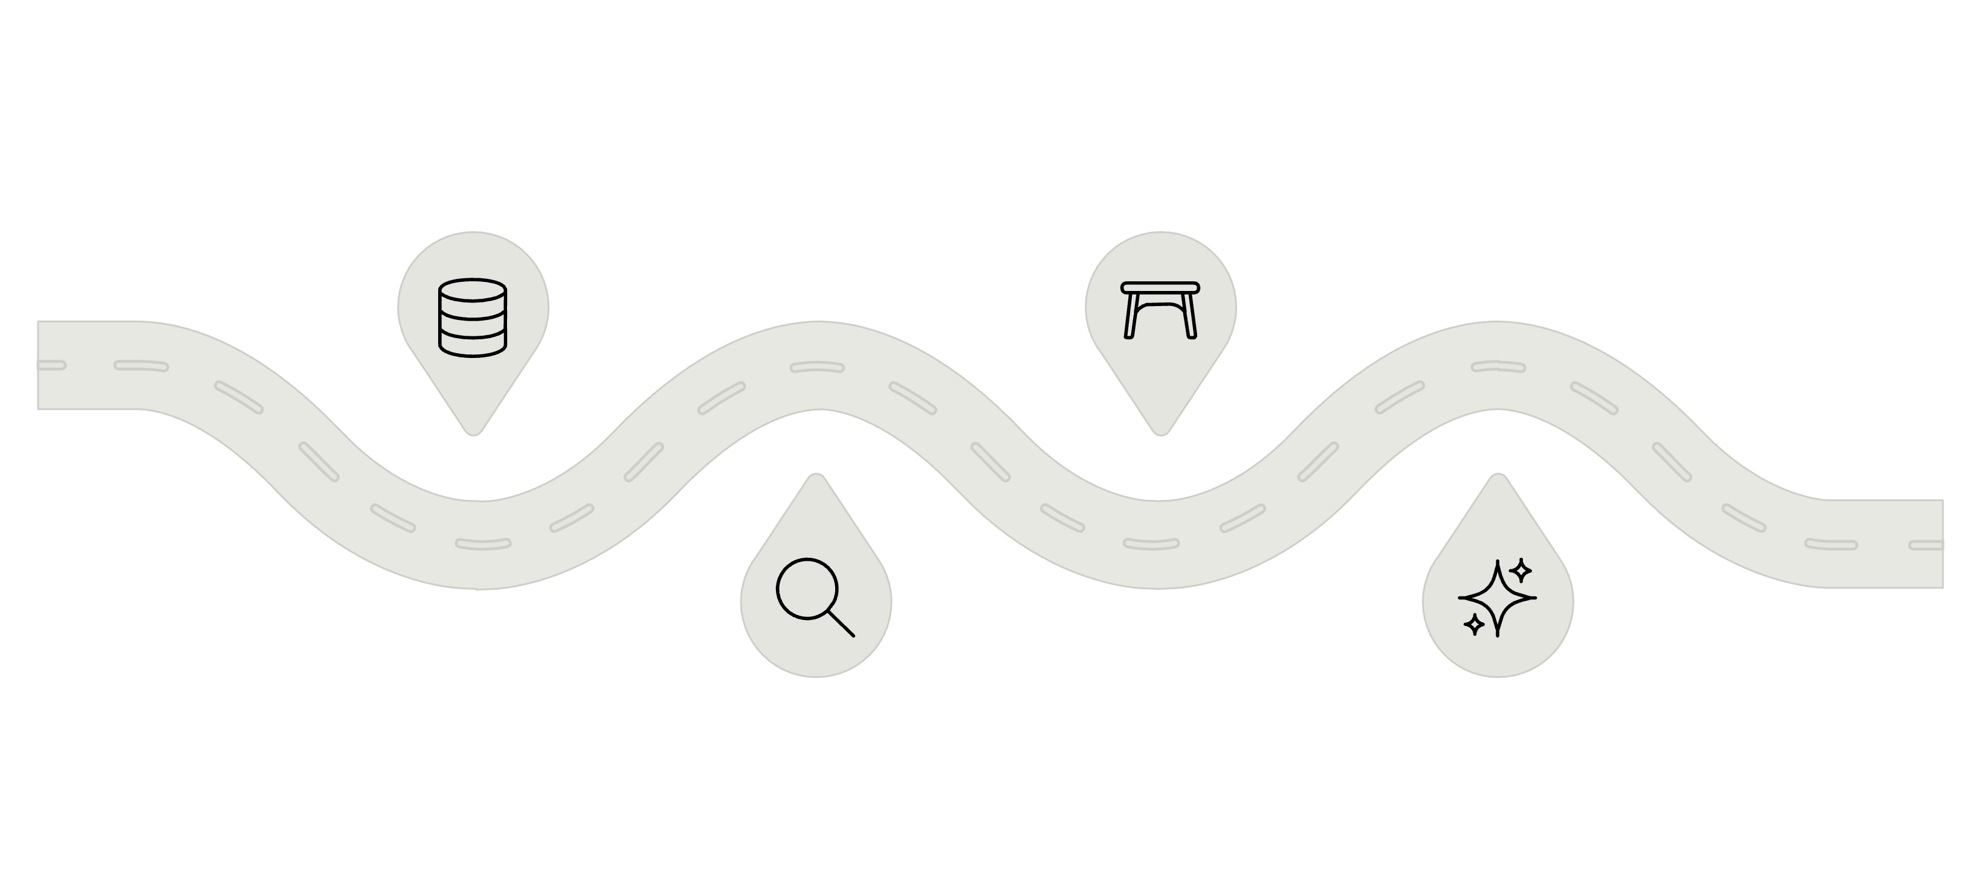

PYTHON ANALYSIS
Data Preparation Pipeline
Load Data
Handle Missing
Import datasets into Python
Impute or drop null values
Explore & Clean
Engineer Features
Inspect and remove anomalies
Create and transform predictors
Comprehensive data cleaning and feature engineering in Python prepared the dataset for deep analysis.

Slide 4

Revenue by Gender
Male Customers
Female Customers
$157,890 total revenue
$75,191 total revenue
68% of total sales
32% of total sales

Slide 5
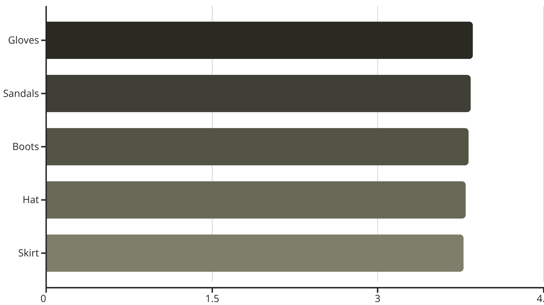
Top Products by Customer Rating
Customer satisfaction varies by product type, with accessories and footwear leading in ratings.
Average rating across all products: 3.75

Slide 6
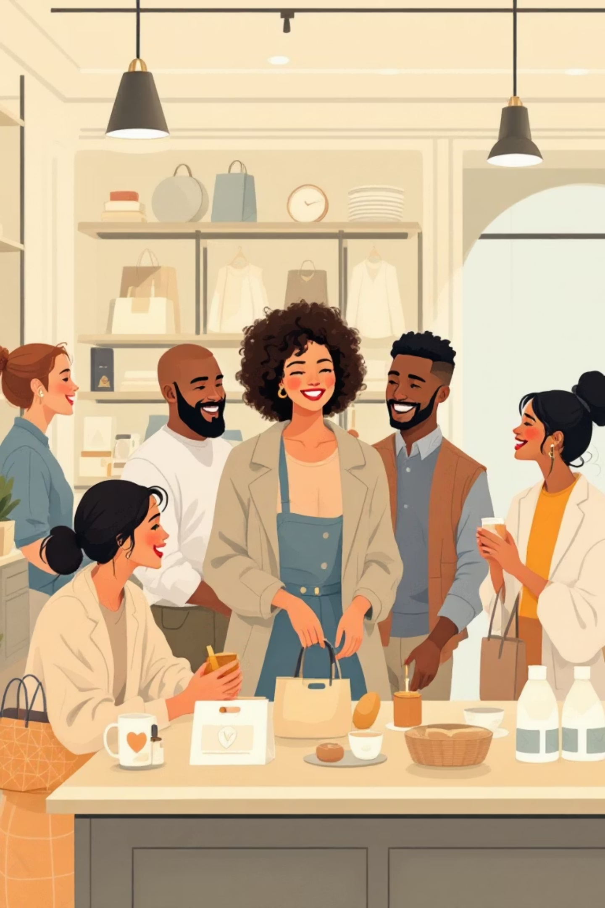



SEGMENTATION
Customer Loyalty Breakdown
80%
18%
Loyal Customers
Returning
3,116 repeat buyers
701 customers
2%
New
83 first-time buyers

Slide 7
Subscription Impact Analysis
27%
73%
Subscribers
Non-Subscribers
1,053 customers
2,847 customers
Key Finding
Subscribers and non-subscribers show similar average spending patterns ($59.49 vs $59.87), but subscribers generate concentrated revenue.
Repeat buyers (>5 purchases) show 958 subscribers vs 2,518 non-subscribers.

Slide 8
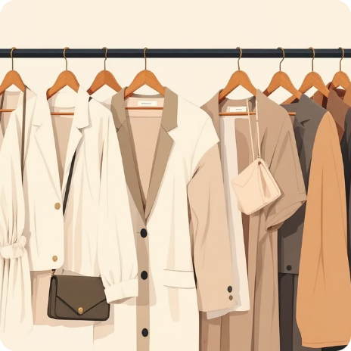


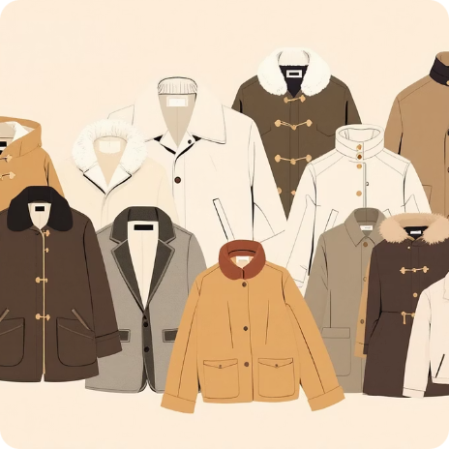
Revenue & Sales by Category
Clothing
Accessories
Footwear
Outerwear
$100K revenue
$70K revenue
$30K revenue
$20K revenue
2,000 sales
1,500 sales
700 sales
400 sales

Slide 9
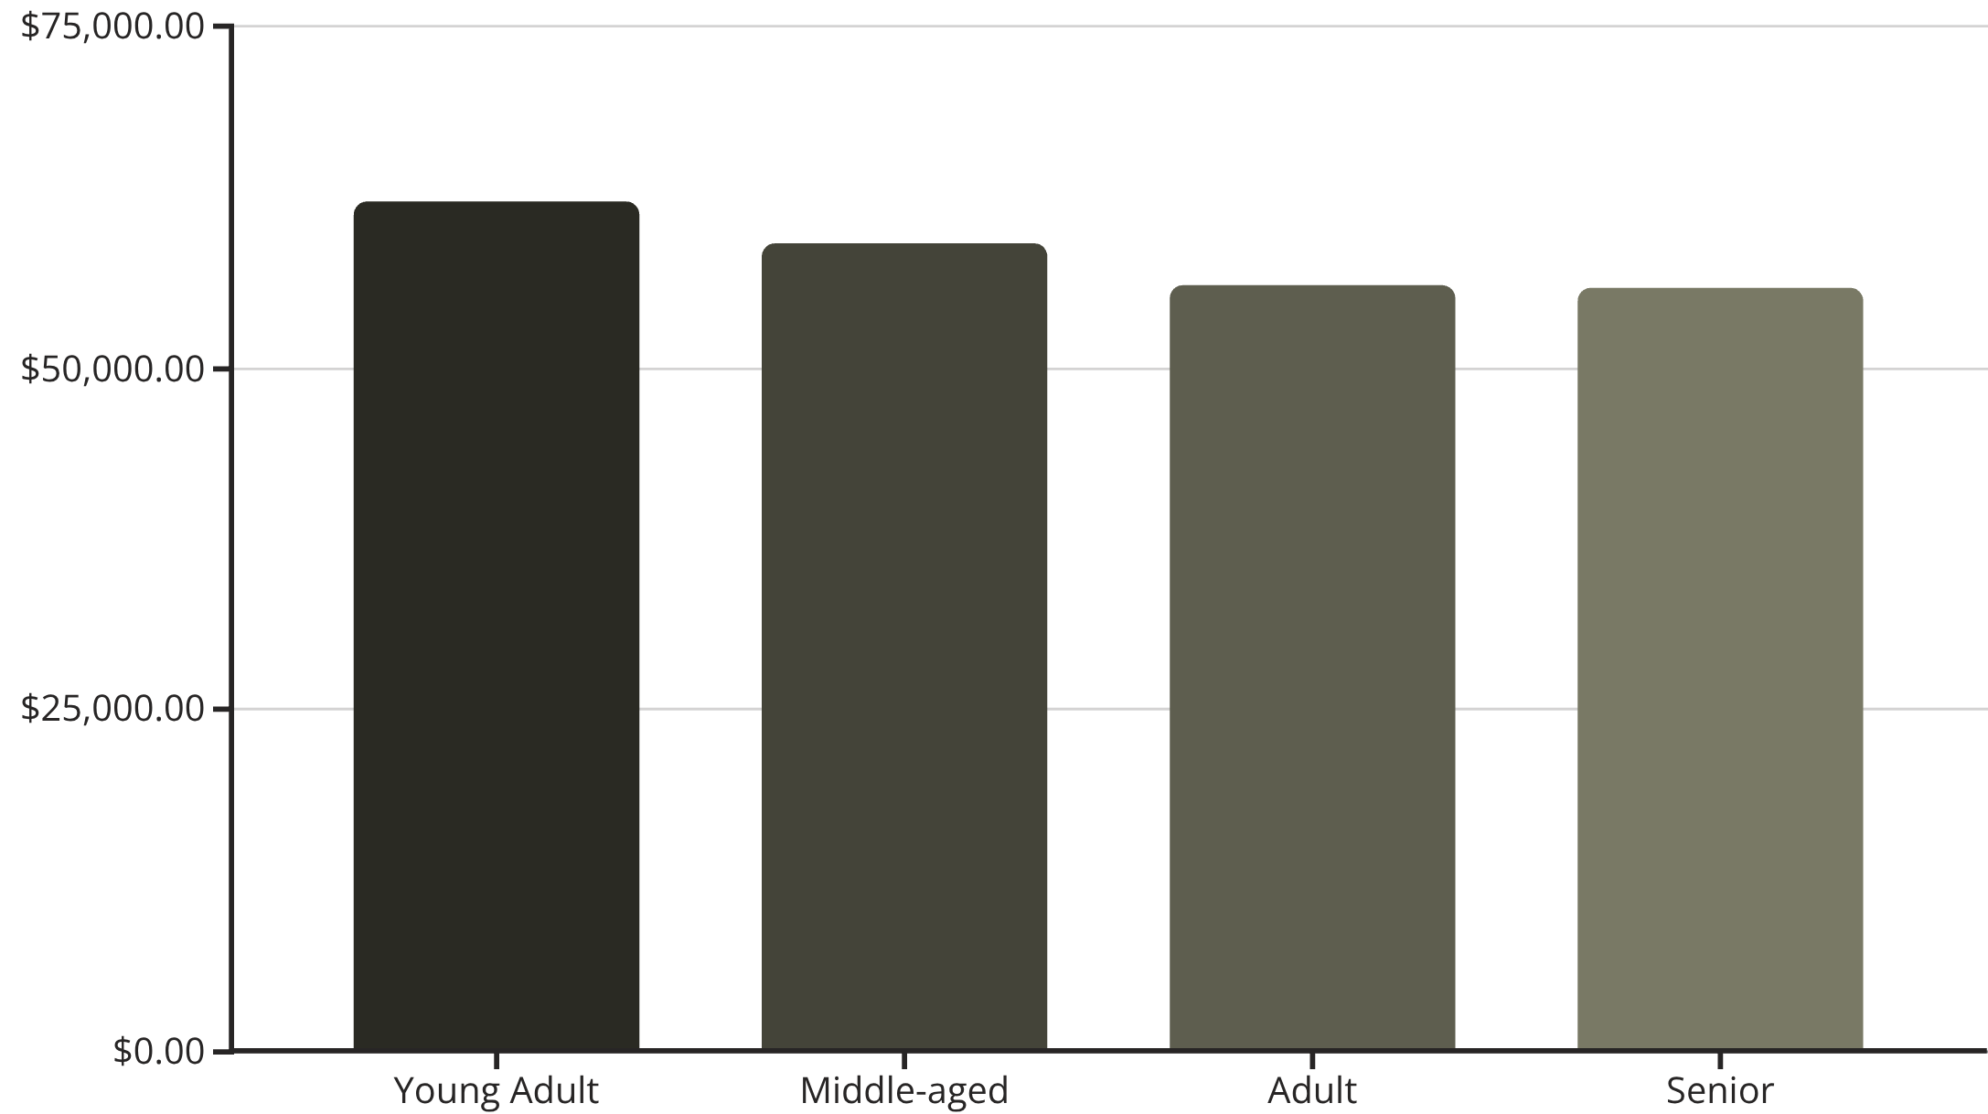
Age Group Revenue Distribution
Demographic Insights
Young adults lead in revenue contribution, followed closely by middle-aged customers.
Relatively balanced spending across all age segments suggests broad market appeal.

Slide 10
STRATEGY
Business Recommendations
Boost Subscriptions
1
Promote exclusive benefits to convert non-subscribers
Loyalty Programs
2
Reward repeat buyers to strengthen retention
Review Discount Policy
3
Balance sales growth with margin control
Product Positioning
4
Highlight top-rated items in marketing campaigns
Targeted Marketing
5
Focus on high-revenue age groups and express shipping users

